Slide 1


Short-term electricity demand forecasting
Tutorial
Fabian Bastin Department of Computer Science and Operations Research CIRRELT, IVADO
May 7th, 2024

Slide 2

Short circuit
Brief introduction to short-term electricity demand.
Contextual introduction.
Let’s play with open data!
Patrimonial models at Hydro-Québec.
Castor Lab and the emergence of AI.
Model combinations.
Research funded by MITACS and NSERC, in collaboration with Hydro-Québec.
Work mainly done in collaboration with the inflows and demand forecasting unit.
Some of the exposed material is available at https://github.com/UncertainLab/demandtuto

Slide 3

A global addiction to energy

Slide 4
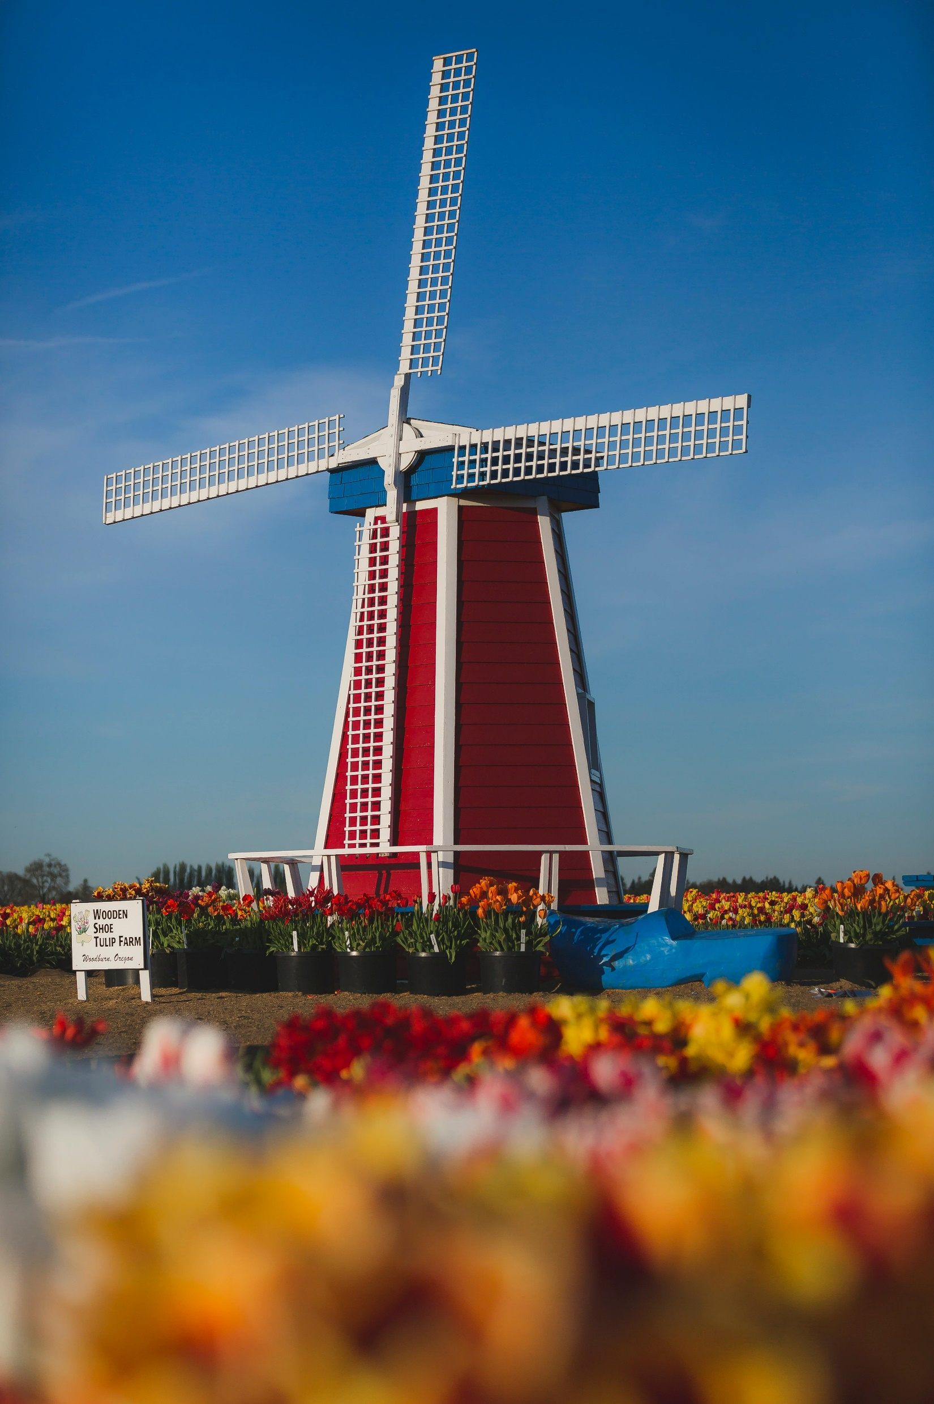

Evolution of energy use
Insights from Our Word in Data.
Python Jupyter notebook.

Slide 5
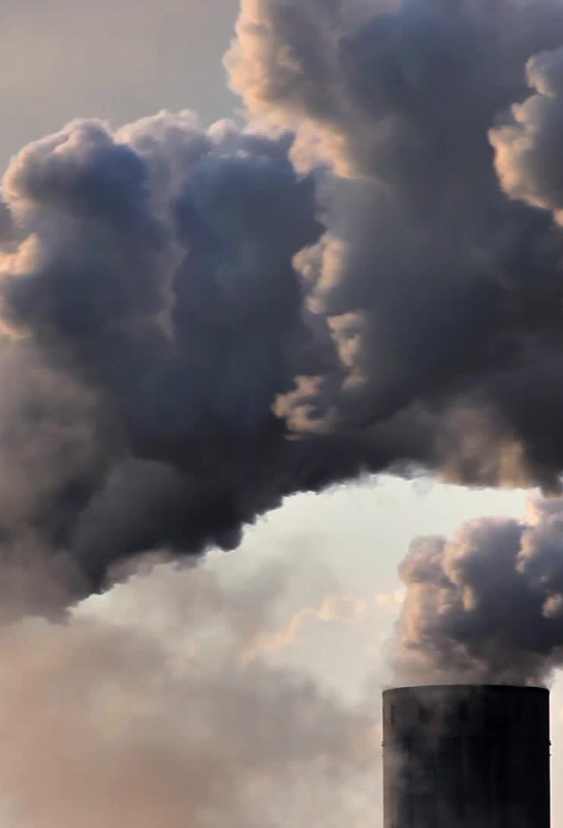
Electricity market share
Accounts for about 20% of the world’s total final consumption of energy.
Its share of energy services is higher due to its efficiency.
In 2021, it accounted for
59% of all the coal used globally,
34% of natural gas,
4% of oil,
52% of all renewables.
nearly 100% of nuclear power.
It also accounted for over one-third of all energy-related CO₂ emissions in 2021.
Source: World Energy Outlook 2022

Slide 6
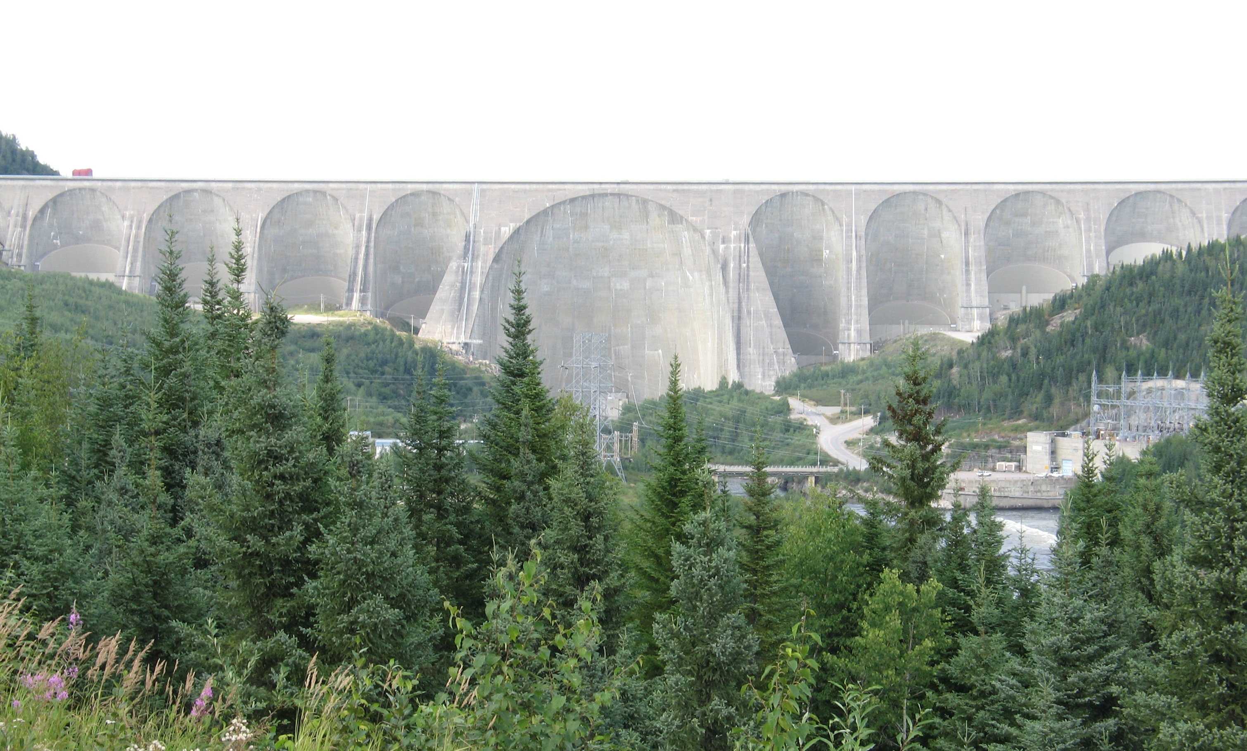
The Québec case: Hydro-Québec*
Source | Installed power (GW) | Production (TWh)
Nuclear | - | -
Hydropower | 36.8 (89.7%) | 175.5 (92.7%)
Fossil | 0.5 (1.2%) | ≈0
Wind | 3.5 (8.5%) | 11.7 (6.2%)
Solar | - | -
Total | 41 (100%) | (100%)
Hydro-Québec provincially owned corporation.
Provides nearly all the electricity consumed in Québec.
Fourth largest hydropower producer in the world.
Installed power per million of inhabitants: 5 GW.
2.5 times the installed power per million of inhabitants in France.
Production per million of inhabitants: 22.5 TWh.
2.7 times the electricity produced per million of inhabitants in France.
* 2018 numbers.

Slide 7
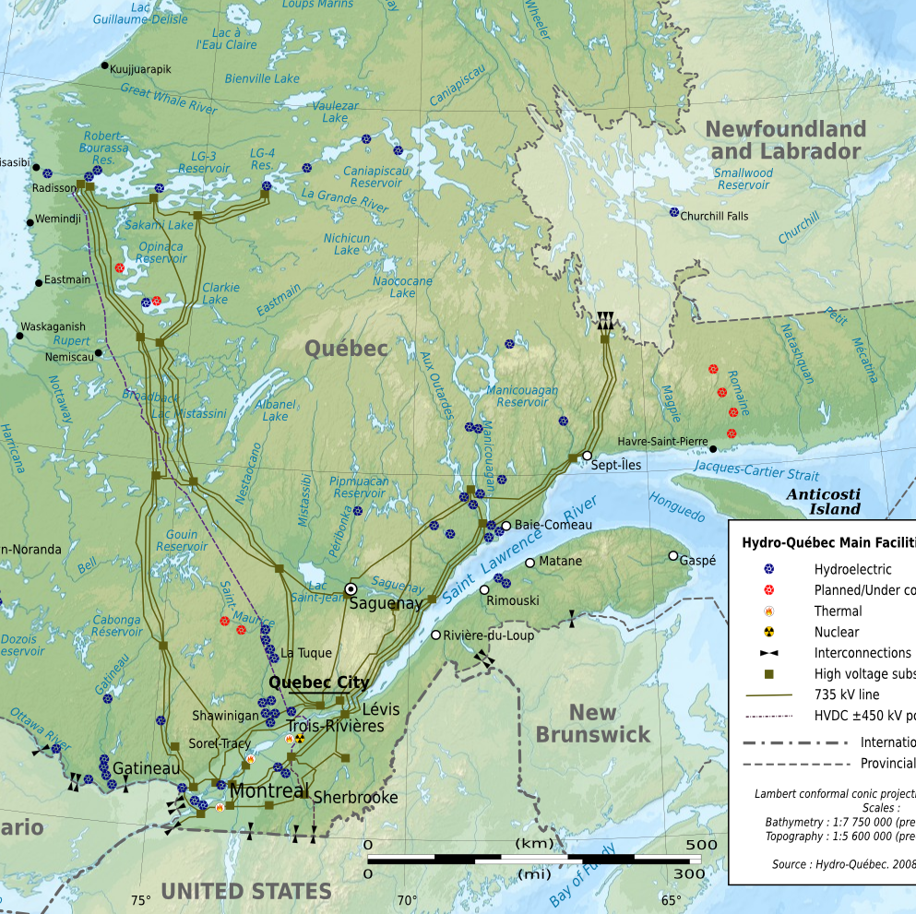
An energy from far, far away…
High and extra high voltage power lines (315 to 735 kV).
Centralize management of the Quebec network in Montreal.
34,272 km of lines.

Slide 8
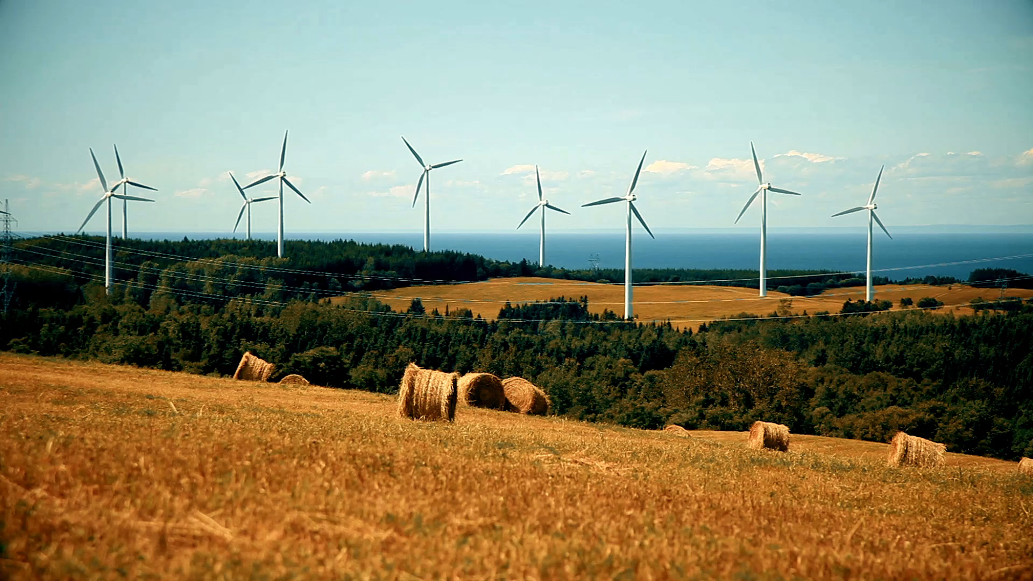
The Québec case: share of renewable energies

Slide 9
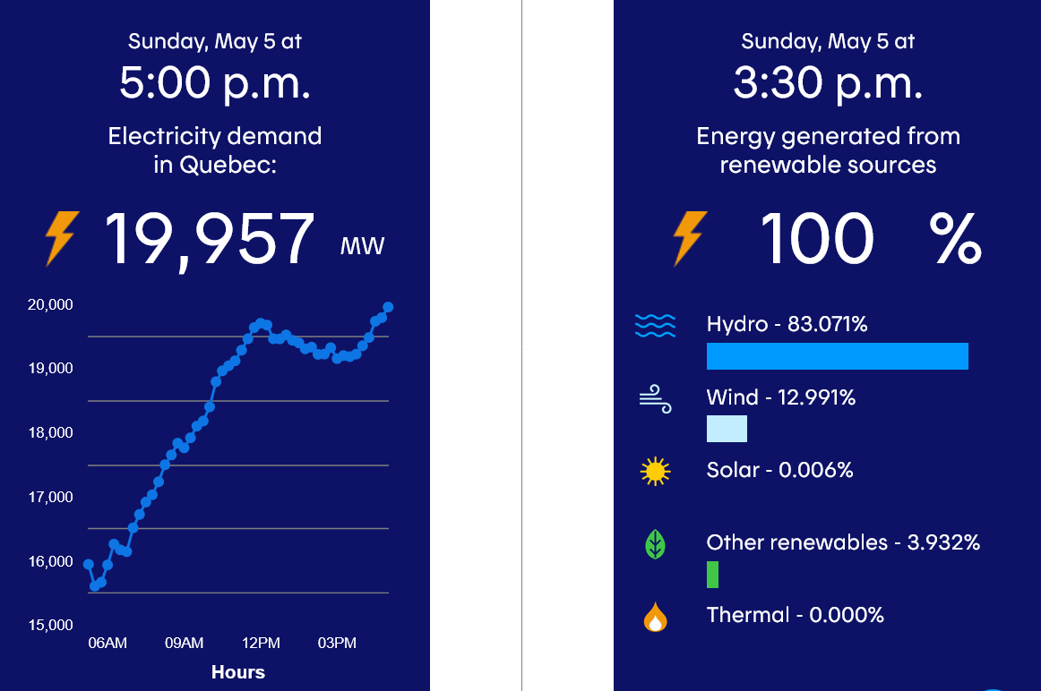

Slide 10
A first exploration using open data
Special thanks to Jérôme Emery and Stéphane Dellacherie

Slide 11
Day-ahead demand forecasting
We here interested by the short-term electricity demand.
Short-term: up to 24 hours in the future.
We start by building a simplified model using available open data.
Main limitation: the total provincial demand only is given.
Real models deployed by Hydro-Québec take advantage of more detailed information.
Investigation done using a Python Jupyter notebook.
More details at Jérôme Emery’s github page: https://github.com/UncertainLab/Electricity-load-forecasting

Slide 12
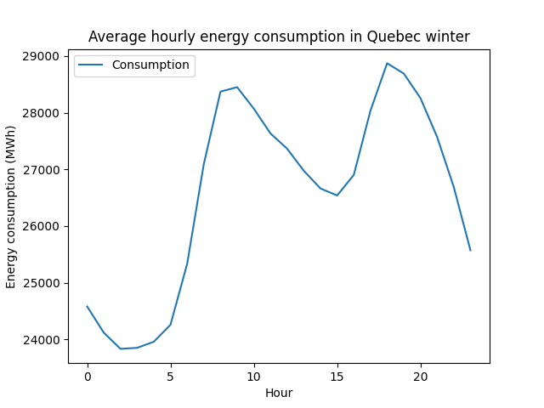
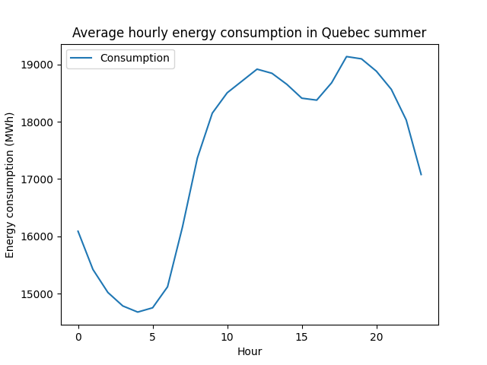
Hourly demand patterns
Morning and night consumption peaks

Slide 13
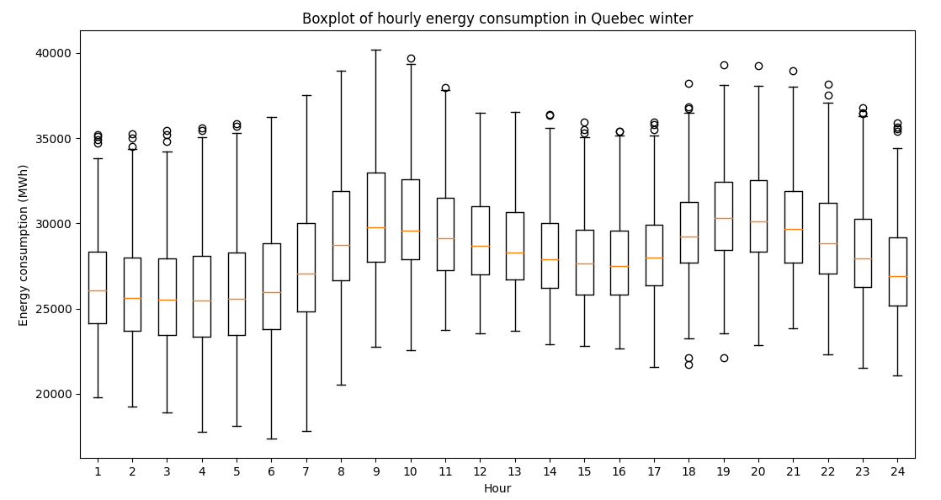
Hourly demand patterns

Slide 14
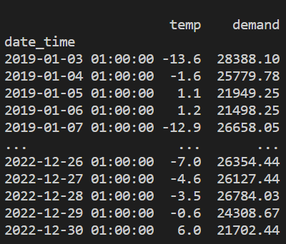
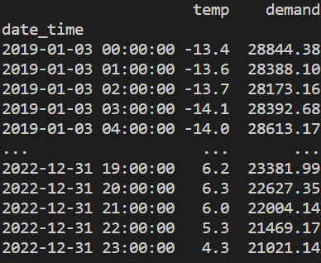
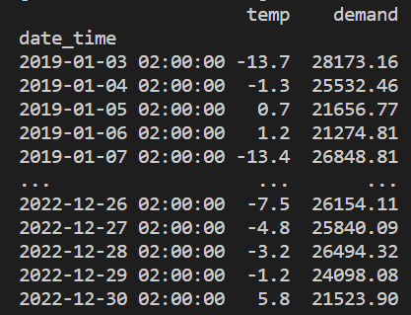
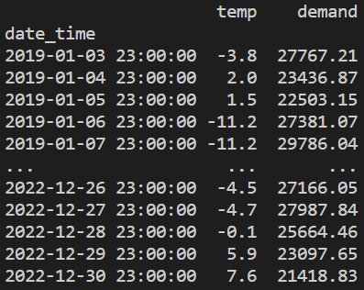

Model
One model for every hour. (24 different models)
$$⋮$$

Slide 15
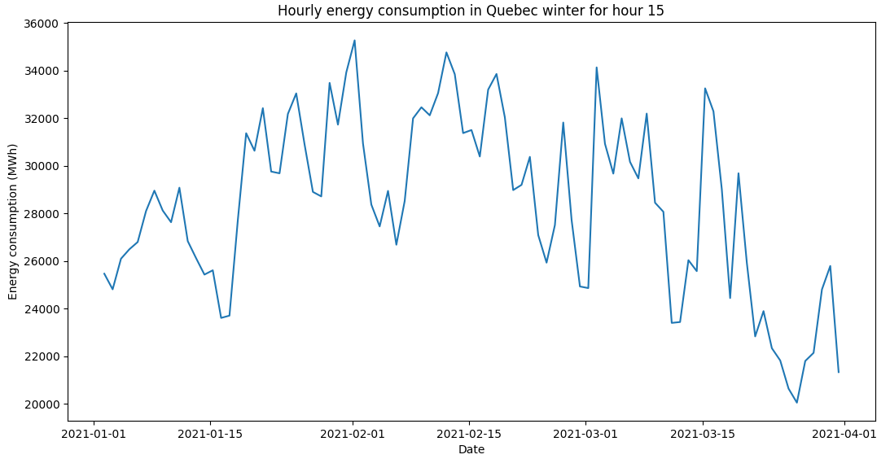
Model
Forecast the log of the demand.
Model predictors:
lagged temperatures
weekday vs end of week;
cloud cover.

Slide 16
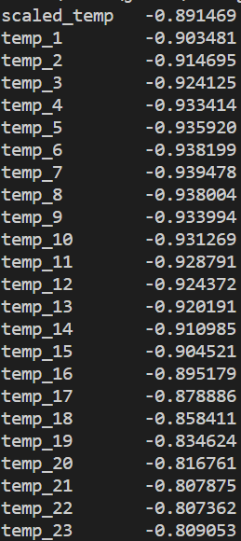
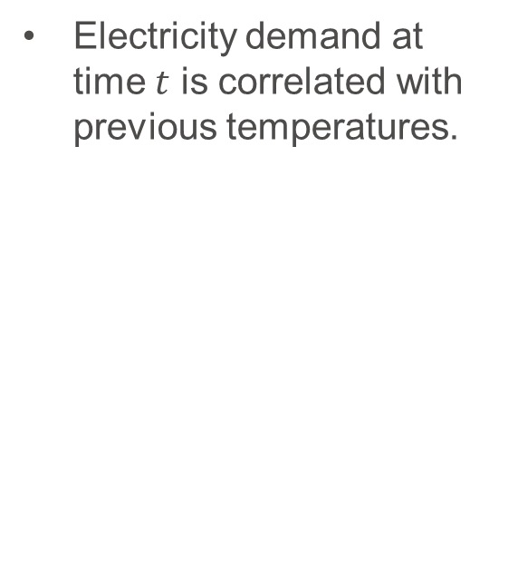
Lagged temperatures
Electricity demand at time $t$ is correlated with previous temperatures.
Correlation coefficients between current electricity demand and previous temperatures (scaled in [-1,1]) for hour 2.

Slide 17
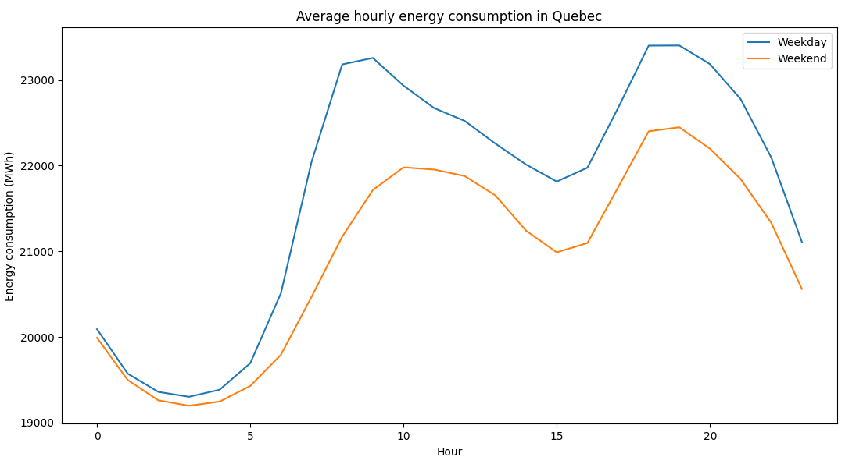
Type of day
Binary encoding weekday (0) and weekend day (1).

Slide 18
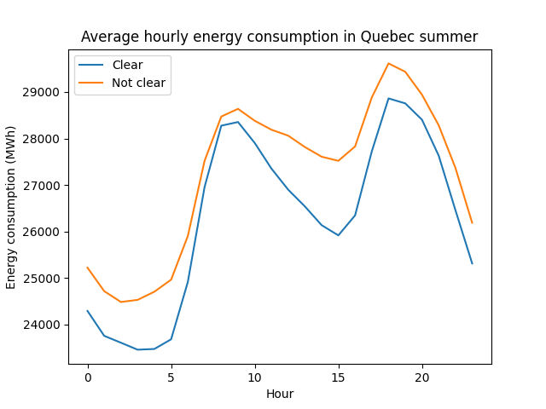
Cloud cover
Binary encoding if sky is clear (1) or not (0).

Slide 19
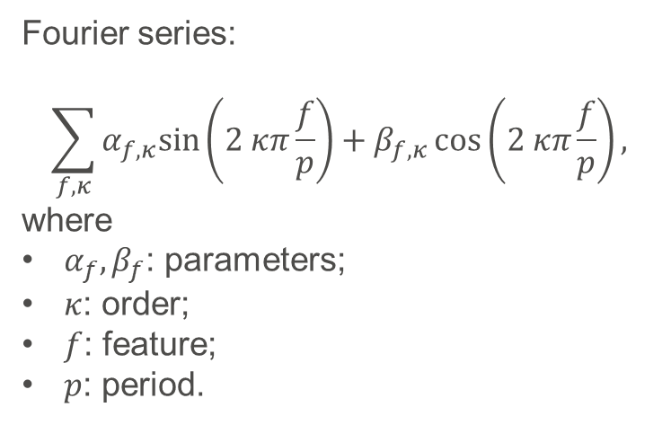
Models
Fourier series:
$$\sum_{f,κ}{α_{f,κ}sin\left(2 κπ\frac{f}{p}\right)+β_{f,κ}\cos\left(2 κπ\frac{f}{p}\right),}$$
where
$α_{f}, β_{f}$: parameters;
$κ$: order;
$f$: feature;
$p$: period.
Various models can be tried:
multi layer perceptron or more complex neural networks;
autoregressive models as ARMA;
spline regression;
Fourier series;
etc.

Slide 20
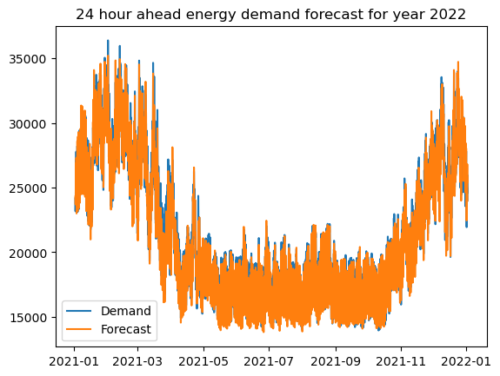
Fourier series
RMSE: 655.41
MAPE: 0.022:
Percentage within 1000 MWh: 87.82%
Percentage within 500 MWh: 61.94%

Slide 21
Parametric models
Special thanks to Pierre Borie, Alain Marcotte, Stéphane Dellacherie, Olivier Milon, Daniel Delahaye

Slide 22
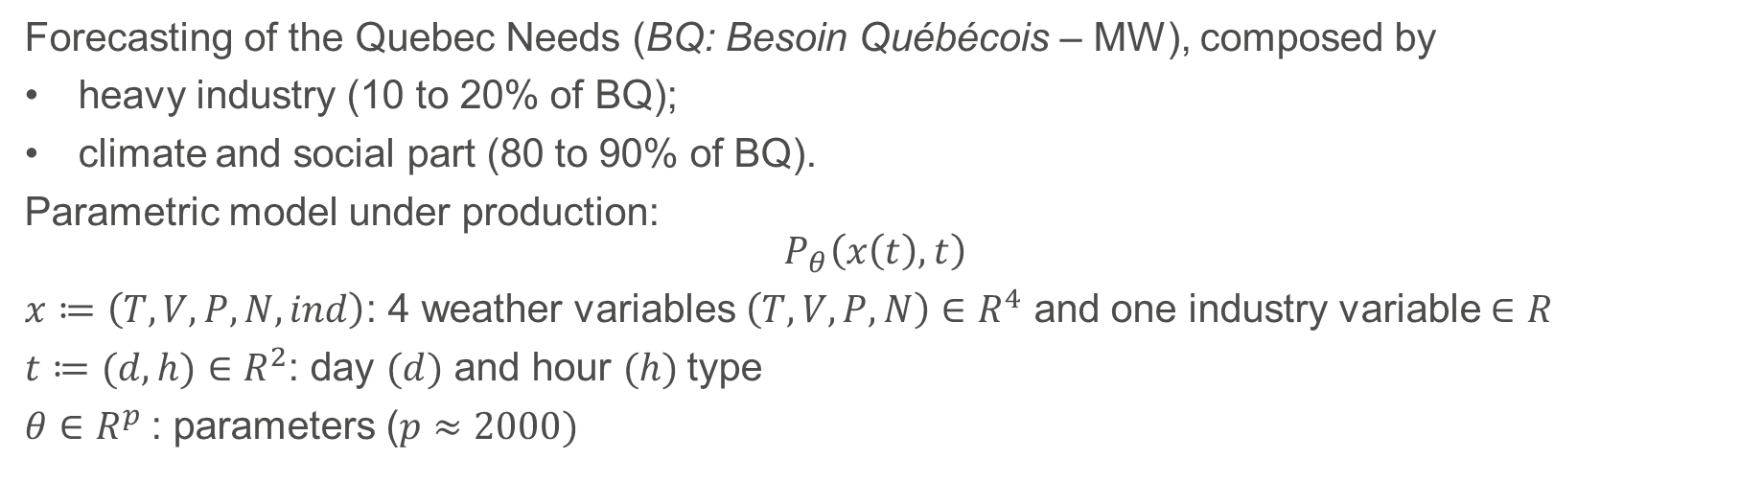
Patrimonial models (1980-2010)
Forecasting of the Quebec Needs (BQ: Besoin Québécois – MW), composed by
heavy industry (10 to 20% of BQ);
climate and social part (80 to 90% of BQ).
Parametric model under production: $$P_{θ}\left(x\left(t\right),t\right)$$
$x≔\left(T,V,P,N,ind\right)$: 4 weather variables $\left(T,V,P,N\right)∈R^{4}$ and one industry variable $∈R$
$t≔(d,h)∈R^{2}$: day $(d)$ and hour $(h)$type
$θ∈R^{p}$: parameters ($p≈2000)$

Slide 23
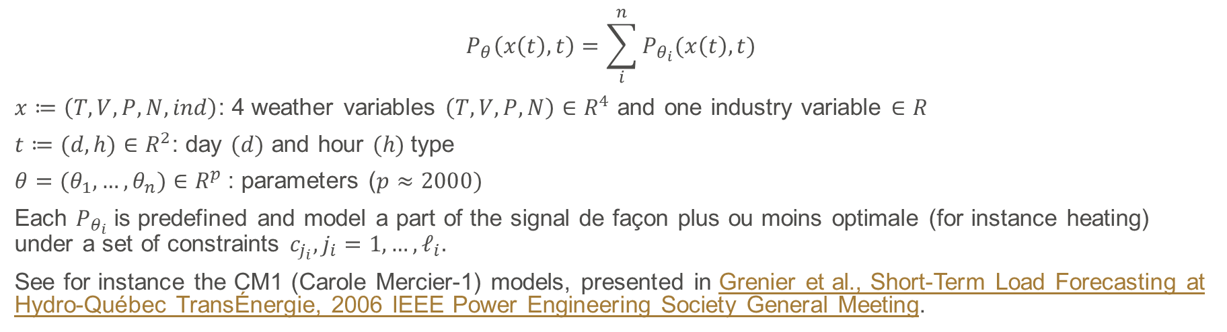
Patrimonial models (1980-2010)
$$P_{θ}\left(x\left(t\right),t\right)=\sum_{i}^{n}{P_{θ_{i}}(x\left(t\right),t)}$$
$x≔\left(T,V,P,N,ind\right)$: 4 weather variables $\left(T,V,P,N\right)∈R^{4}$ and one industry variable $∈R$
$t≔(d,h)∈R^{2}$: day $(d)$ and hour $(h)$type
$θ=(θ_{1},…,θ_{n})∈R^{p}$: parameters ($p≈2000)$
Each $P_{θ_{i}}$is predefined and model a part of the signal de façon plus ou moins optimale (for instance heating) under a set of constraints $c_{j_{i}}, j_{i}=1,…,ℓ_{i}.$
See for instance the CM1 (Carole Mercier-1) models, presented in Grenier et al., Short-Term Load Forecasting at Hydro-Québec TransÉnergie, 2006 IEEE Power Engineering Society General Meeting.

Slide 24
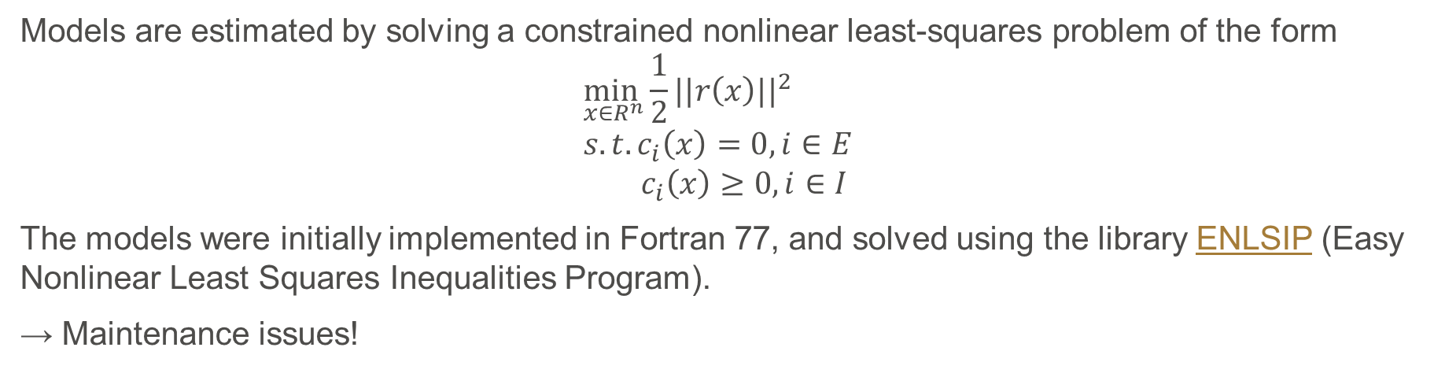
ENLSIP
Models are estimated by solving a constrained nonlinear least-squares problem of the form
$$\min_{x∈R^{n}}\frac{1}{2}||r\left(x\right)||^{2} \\ s.t. c_{i}\left(x\right)=0, i∈E \\ { c}_{i}\left(x\right)≥0, i∈I$$
The models were initially implemented in Fortran 77, and solved using the library ENLSIP (Easy Nonlinear Least Squares Inequalities Program).
→ Maintenance issues!

Slide 25
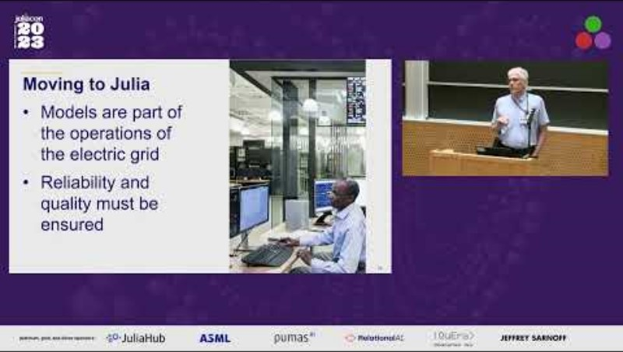
ENLSIP.jl
The code has been migrated to Julia, thanks to Pierre Borie and Alain Marcotte.
JuliaCON 2023 talks:
https://live.juliacon.org/talk/RHTLPD
https://live.juliacon.org/talk/UVEDD3
Available at https://github.com/UncertainLab/Enlsip.jl

Slide 26
Numerical experiments
Estimation of CM1 model parameters, on 90 different instances with the following features:
from 258 to 726 parameters,
from 468 to 716 total constraints (with 2 to 10 equalities),
from 4392 to 17,568 residuals.
Comparison between Julia and Fortran versions:
26 instances either failed to converge or stopped because of a numerical error occurring during the execution of both versions.
These results were due to inconsistencies in the problem formulation of a given family of instances and thus, they do not reflect the robustness of the method implemented in ``ENLSIP``.
For the 64 remaining instances, both versions reached similar solutions that met Hydro-Québec specifications.

Slide 27
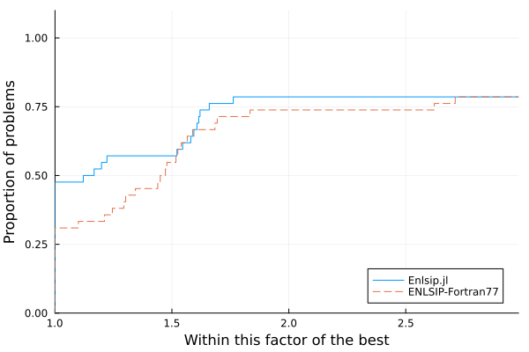
Performance profile

Slide 28
Demand forecasting: Combination of models
Special thanks to Stéphane Dellacherie, Alexandre Deslauriers, Olivier Milon, Jérôme Emery, Clémence Granade

Slide 29
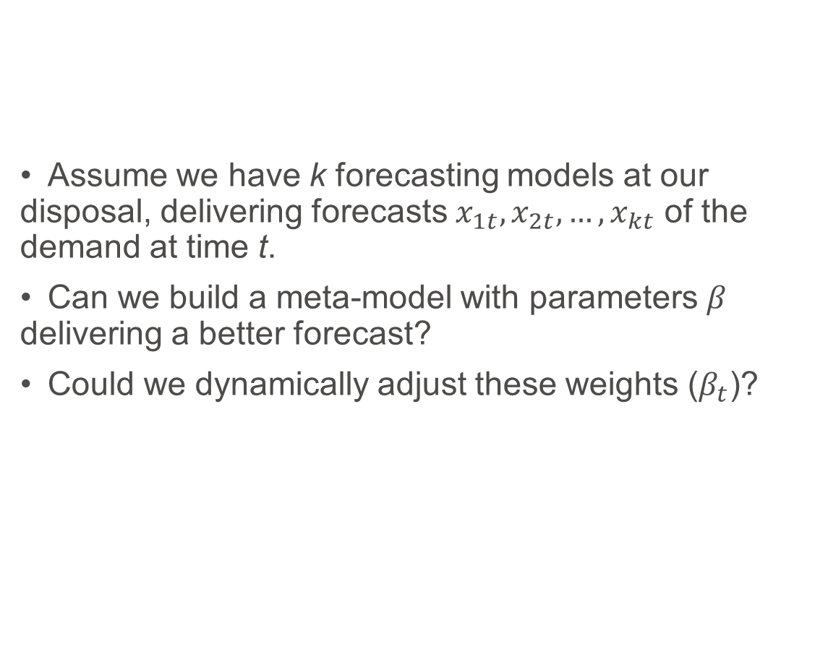
Combination of forecasting models
Assume we have k forecasting models at our disposal, delivering forecasts $x_{1t}, x_{2t},…,x_{kt}$ of the demand at time t.
Can we build a meta-model with parameters $β$ delivering a better forecast?
Could we dynamically adjust these weights ($β_{t}$)?

Slide 30
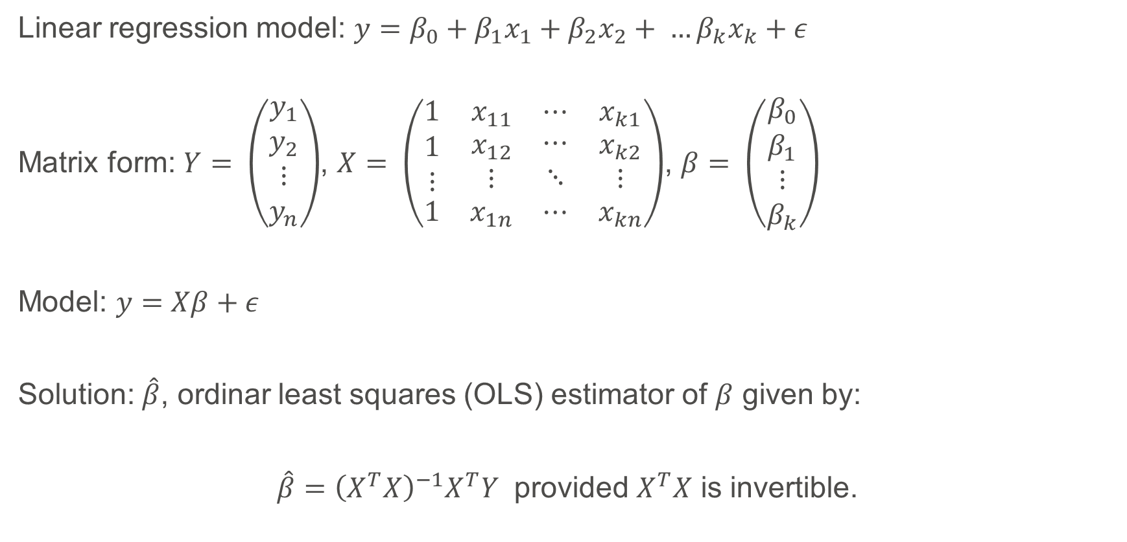
Least-squares regression
Linear regression model: $y=β_{0}+β_{1}x_{1}+β_{2}x_{2}+ …β_{k}x_{k}+ε$
Matrix form: $Y= \left(\begin{aligned}y_{1} \\ y_{2} \\ ⋮ \\ y_{n}\end{aligned}\right)$, $X= \left(\begin{matrix}1 & x_{11} & ⋯ & x_{k1} \\ \begin{aligned}1 \\ ⋮\end{aligned} & \begin{aligned}x_{12} \\ ⋮\end{aligned} & \begin{aligned}⋯ \\ ⋱\end{aligned} & \begin{aligned}x_{k2} \\ ⋮\end{aligned} \\ 1 & x_{1n} & ⋯ & x_{kn}\end{matrix}\right)$, $β= \left(\begin{matrix}β_{0} \\ \begin{aligned}β_{1} \\ ⋮ \\ β_{k}\end{aligned}\end{matrix}\right)$
Model: $y=Xβ+ε$
Solution: $\hat{β}$, ordinar least squares (OLS) estimator of $β$ given by:
$\hat{β}={\left(X^{T}X\right)}^{−1}X^{T}Y$ provided $X^{T}X$ is invertible.

Slide 31
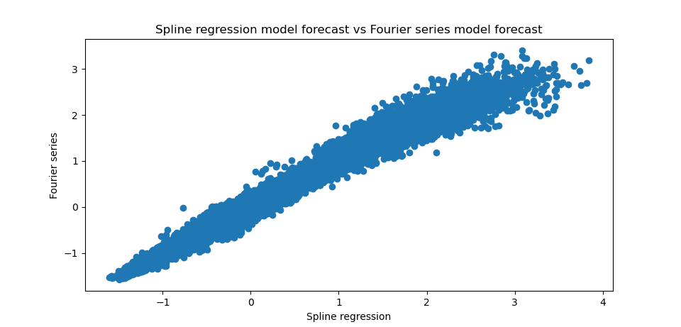
Multicollinearity
For a time window of 30 days, correlation coefficient between two models can vary between 0.90 and 0.99.

Slide 32
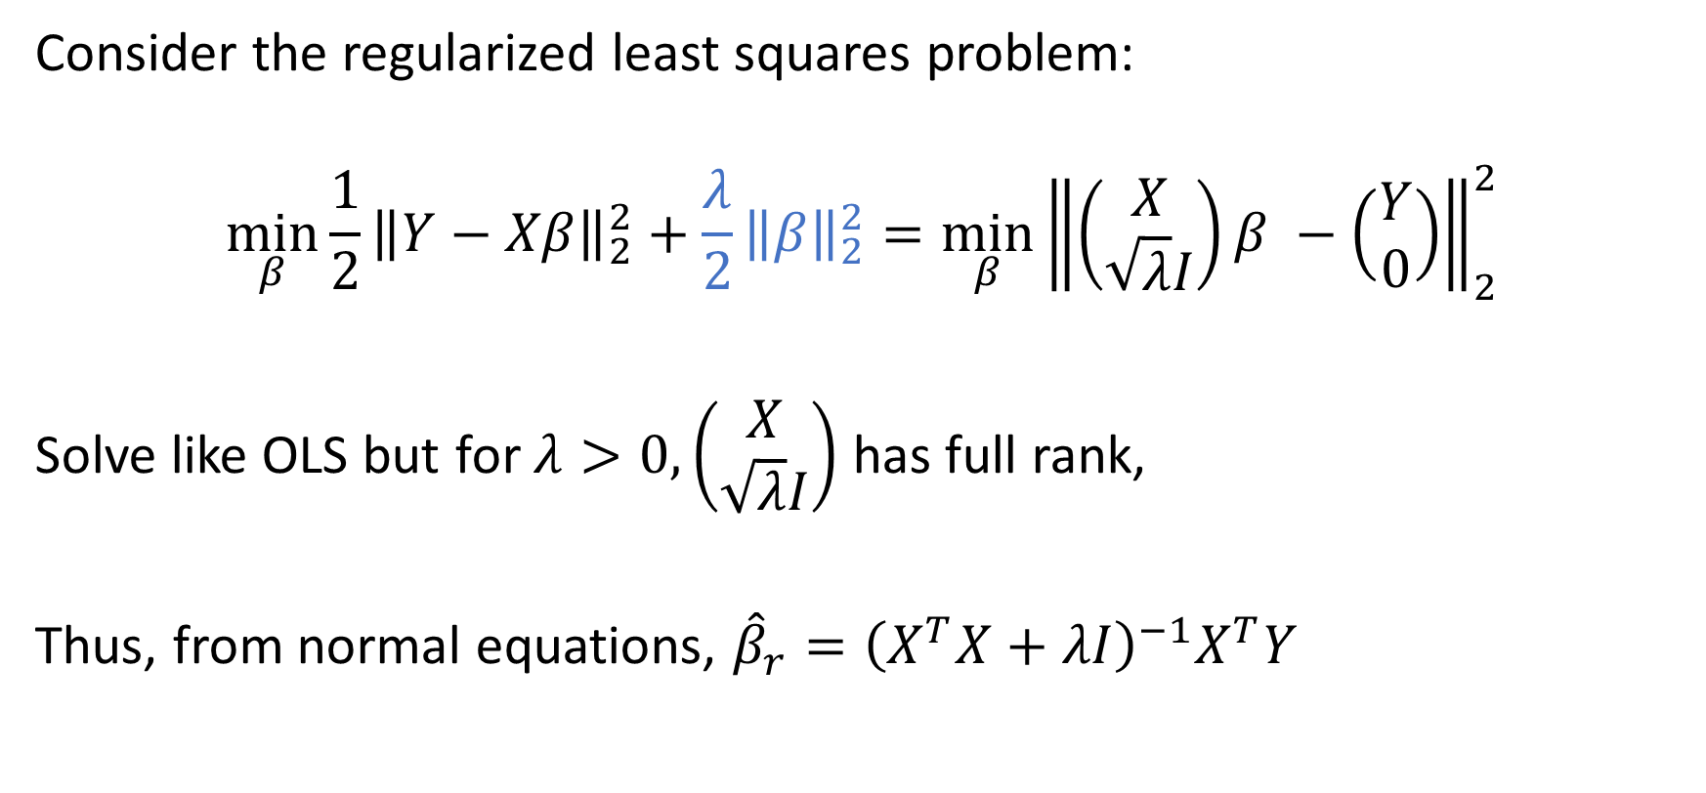
Regularization
Consider the regularized least squares problem:
$$\min_{β}{\frac{1}{2}{\left\|Y−Xβ\right\|}_{2}^{2}+\frac{λ}{2}{\left\|β\right\|}_{2}^{2}}=\min_{β}{{\left\|\left(\begin{aligned}X \\ \sqrt{λ}I\end{aligned}\right)β −\left(\begin{aligned}Y \\ 0\end{aligned}\right)\right\|}_{2}^{2}}$$
Solve like OLS but for $λ>0, \left(\begin{aligned}X \\ \sqrt{λ}I\end{aligned}\right)$ has full rank,
Thus, from normal equations, ${\hat{β}}_{r}={\left(X^{T}X+λI\right)}^{−1}X^{T}Y$

Slide 33
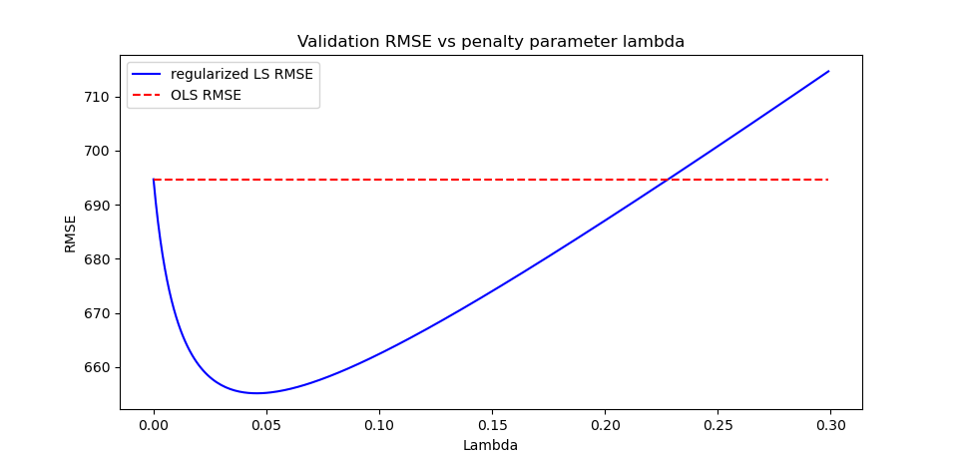
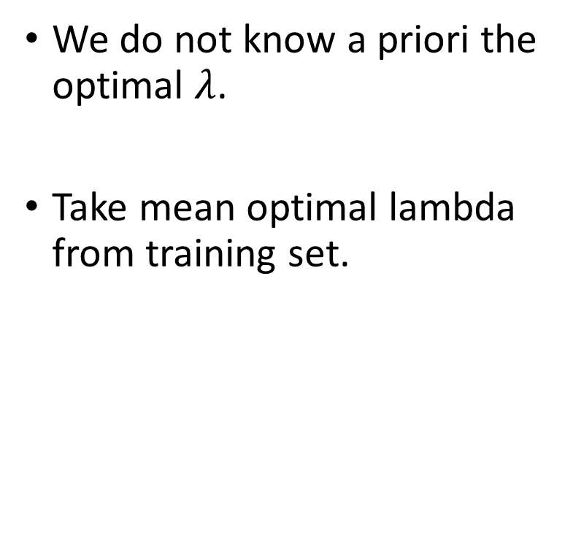

Regularization – determining $λ$
We do not know a priori the optimal $λ$.
Take mean optimal lambda from training set.

Slide 34
Results – Regularized ensemble method
Best model – Fourier series
RMSE: 656 MW
MAPE: 2.24 %
OLS ensemble method
RMSE: 601 MW
MAPE: 1.95 %
Ridge ensemble method
RMSE: 553 MW
MAPE: 1.82 %

Slide 35
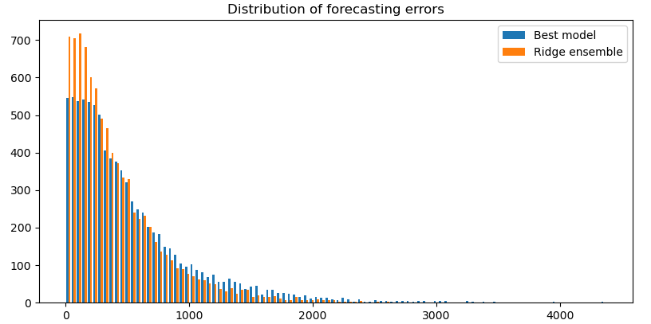
Errors

Slide 36
Possible improvements
Other combinations are possible:
variance reduction approaches;
linear regression;
online learning;
reinforcement learning;
…
Current investigations pursued by Clémence Granade.

Slide 37
Demand forecasting: energy transition and AI
Special thanks to Stéphane Dellacherie, Frédéric Gagné, Clémence Granade

Slide 38

Demand patterns are changing…
New equipments (IOT, isolation, air conditioning,…);
Behavioral change: energy saving, homeworking, urban sprawl,…;
Industry change: rise and falls of industrial sectors;
Increase of the thermal sensitivity;
Climate change leading to more frequent extreme events (warmer and colder).
Models (objectives and constraints) have to be revised but it is more and more complex.
Use of novel machine learning models, and creation of the cloud-computing CASTOR lab.
Projet CASTOR
IntelligenCe Artificielle
en appui au développement d'une préviSion de charge
adaptée à la TransitiOn éneRgétique

Slide 39
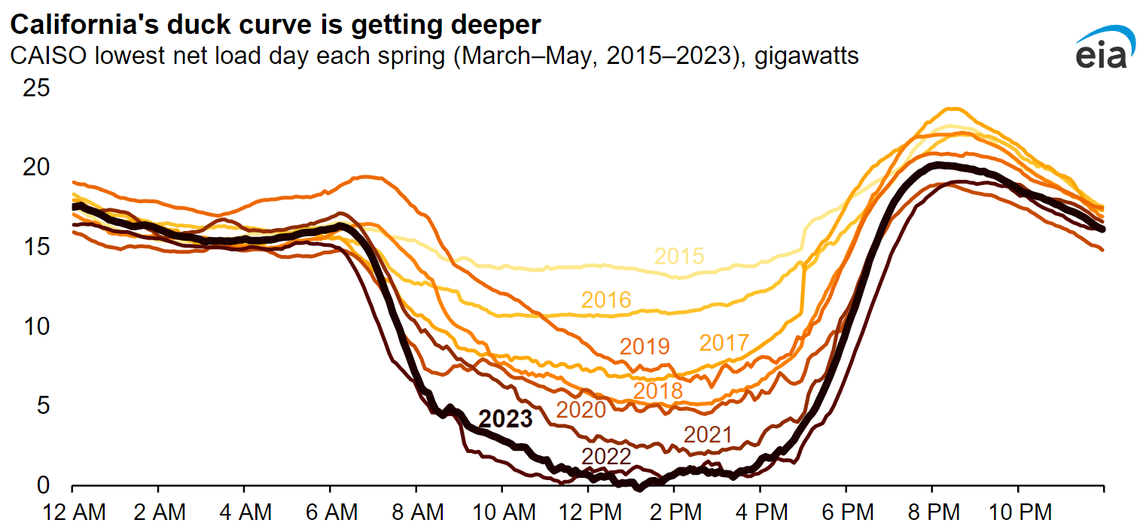
Possible impact of renewable energies
Source: https://www.pv-magazine.com/wp-content/uploads/2023/07/EIACalifornia.png

Slide 40
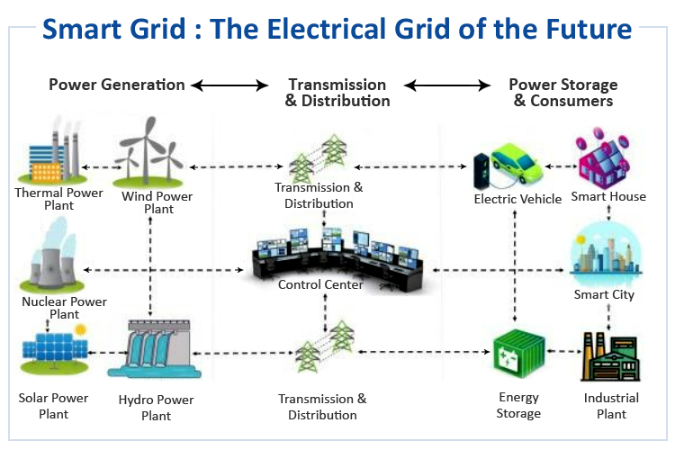
Effects of smart grids
Source: https://circuitdigest.com/article/smart-grid-the-electrical-grid-of-the-future

Slide 41
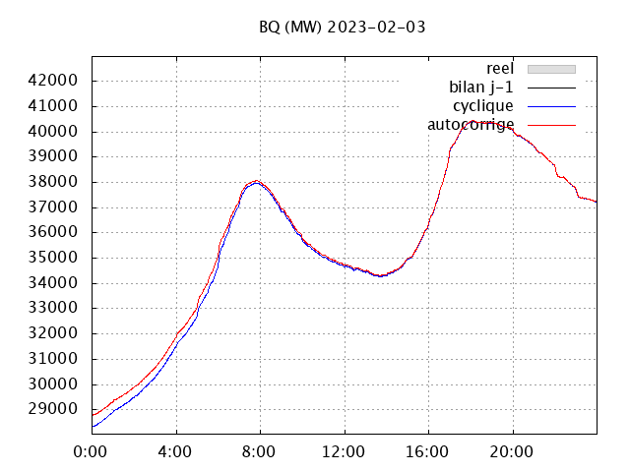
Demand patterns are changing…
Source: S. Dellacherie

Slide 42
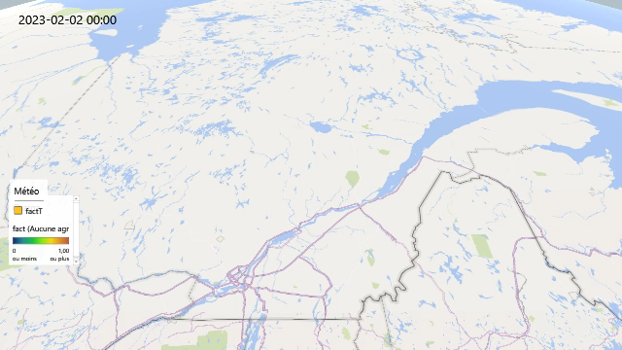
Satellite stations
Source: S. Dellacherie

Slide 43
Satellite stations
Exploration on the demand forecasting for 4 stations by Frédéric Gagné.

Slide 44
Satellite stations
 | Chomedey station |  |  | DesSources station
Model | RMSE | MAPE | Training time (s) | RMSE | MAPE | Training time (s)
Linear regression | 125.55 | 12.86 | 0.02 | 12.73 | 3.79 | 0.01
Wide & Deep | 141.87 | 14.95 | 85.78 | 12.64 | 3.94 | 57.90
Gradient Boosting | 130.35 | 13.18 | 1.04 | 12.17 | 3.21 | 0.82
LSTM | 147.27 | 12.89 | 1965.98 | 10.37 | 3.50 | 7360.18
TCN | 125.49 | 14.72 | 11839.74 | 7.77 | 2.54 | 1226.84
TSMix | 113.01 | 10.98 | 851.83 | 9.70 | 4.03 | 540.04

Slide 45
Satellite stations
 | Langelier station |  |  | StAnne station
Model | RMSE | MAPE | Training time (s) | RMSE | MAPE | Training time (s)
Linear regression | 7.33 | 2.95 | 0.01 | 8.85 | 5.80 | 0.15
Wide & Deep | 7.37 | 2.87 | 56.89 | 7.15 | 4.52 | 42.05
Gradient Boosting | 7.04 | 2.70 | 1.01 | 8.89 | 5.75 | 0.66
LSTM | 8.49 | 2.80 | 5740.21 | 7.49 | 4.77 | 5294.03
TCN | 6.82 | 2.57 | 1106.63 | 6.68 | 4.19 | 819.07
TSMix | 8.01 | 3.89 | 666.60 | 8.08 | 5.96 | 684.64

Slide 46
Perspectives

Slide 47

Towards a new world

Slide 48
Our dependence towards enery, in particular electricity, will not go down.
Climate change, behavioral change, industry transformation, decentralized grid, new power sources, etc., lead to the need to revise forecasting models.
Parametric models are still important to capture well-explained physical phenomenon.
But they can require time to be refined, while the changes happen fast.
Machine learning can supplement some modeling difficulties.
But we must be vigilant on issues as overfitting, change of data distributions, interpretations difficulties.
But this is the kind of research that gives you lot of energy! Thanks to all the collaborators, Hydro-Québec, MITACS, NSERC, IVADO, University of Montréal.

Slide 49


Questions?

